Slide 1

Forecasting, Future Value and NPV Analysis with Power BI
Leveraging Data for Strategic Decision-Making:
Name Mohamed Yassen

Slide 2

Agenda
Forecasting: Revenue, Profit, and Units Sold.
Future Value (FV): Calculated for 2% and 5% discount rates.
Net Present Value (NPV): A/B Testing to compare projects.
Row-Level Security (RLS): Implemented for data privacy.

Slide 3

Data Sources: Excel sheets: 1-sales data: cash flow table 2-financial data: sales fact table 3- the measures as : NPV, FV ,A/B testing values are in measures table.

Slide 4
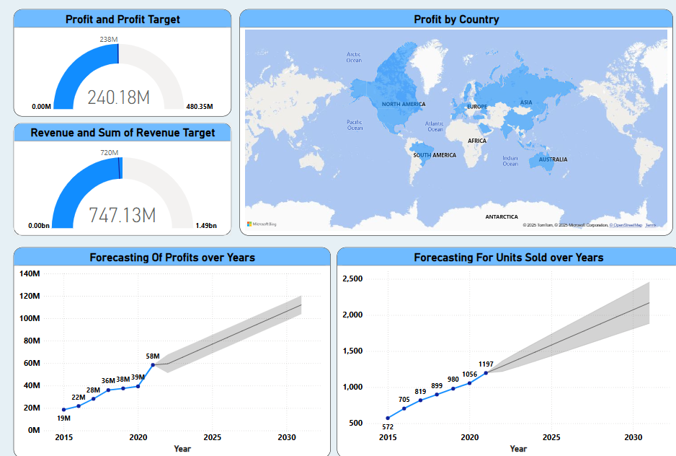
Forecasting
Forecasting is the process of predicting future trends, outcomes, or events based on historical data and analysis. It helps organizations make informed decisions by estimating future performance and planning accordingly.

Slide 5
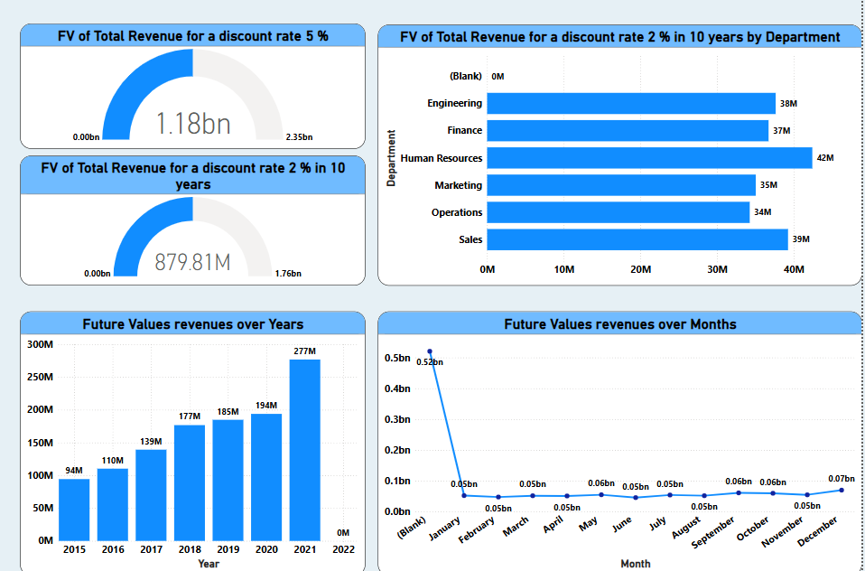
Future Value (FV) Analysis
Future Value Analysis is the process of calculating the value of an investment or cash flow at a future date, considering a specific interest rate or growth rate. It helps in evaluating the potential growth of investments over time

Slide 6
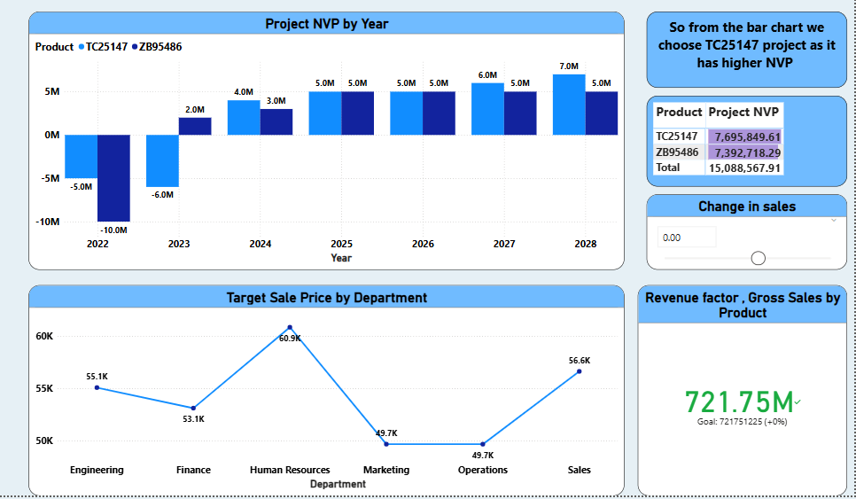
Project NPV (A/B Testing) Analysis
Project NPV (A/B Testing) Analysis
is the process of comparing the Net Present Value (NPV) of two or more projects to determine which one offers the highest financial return.
It helps in making data-driven decisions by evaluating the profitability of alternative investments.

Slide 7
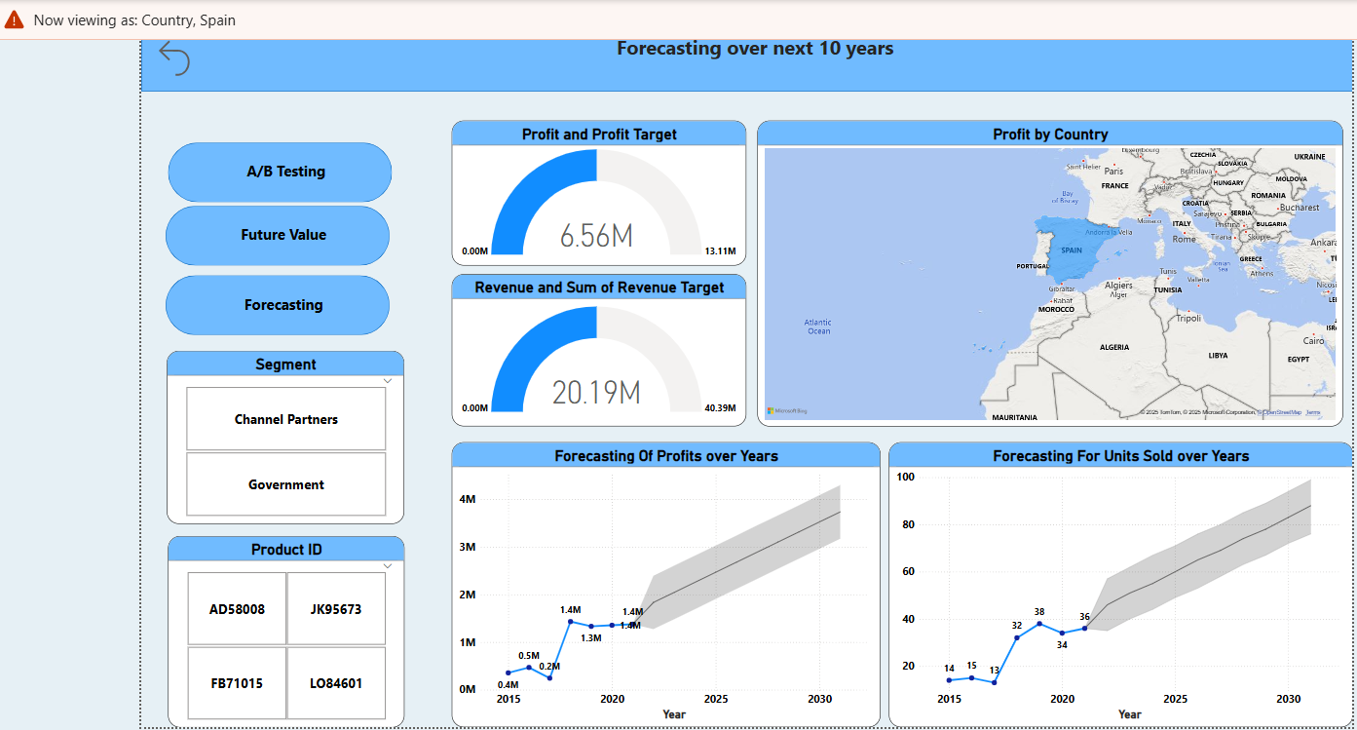
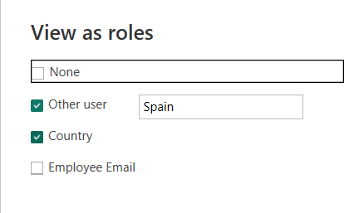
Row-Level Security (RLS)
Row-level security (RLS) analysis
Is the process of implementing data access controls in a project to ensure users can only view or interact with data relevant to their role. It enhances data privacy and security by restricting access at the row level based on predefined rules.

Slide 8
Challenges
Complex DAX Calculations for FV and NPV:
Implementing advanced financial formulas like Future Value (FV) and Net Present Value (NPV) required intricate DAX measures.
Example:
Ensuring Accurate Forecasting Models:
Building reliable forecasting models required careful validation and iterative testing

Slide 9
Solutions:
Used Advanced DAX Functions and Iterative Calculations:
Leveraged DAX functions like FV, XNPV, and CALCULATE to handle complex financial calculations
Validated Models with Historical Data:
Ensured accuracy by comparing forecasted results with historical data and adjusting models accordingly

Slide 10
Conclusion
Learnings:
Enhanced skills in Power BI, DAX, and financial analysis.
Gained experience in forecasting and decision-making.
Next Steps:
Explore more advanced analytics and machine learning integration.

Slide 11
Thank You
GitHub Link:
LINKED IN :
+2001271355892

